Slide 1
Staff-to-Door Allocation (SDA) Model Overview
Evan Lynch
Data Scientist

Slide 2
Agenda
Introductions
Problem Statement
Model Overview
Demo
Discussion

Slide 3
In large-scale distribution centers, the resource allocation decision, or which doors to assign to staff, is difficult due to high volatility in carton volume
Examples of Volume Fluctuation
At a single door over time
Carton volume routed to a single door varies widely throughout the day. In one hour there could be 200 cartons and 20 in the next hour.
Across entire sets of doors at any given time
Volume across an entire set of doors varies widely at any given time. One door could be receiving 200 cartons, while the next two doors receive nothing.
As a manager, how can I allocate my staff such that they can meet the productivity goal, when volume is constantly shifting?

Slide 4
There are generally two methodologies one could use to allocate staff to sets of doors
Door-Based Policy
Volume-Based Policy
Spread the door assignments evenly across the staff by taking the number of doors divided by the number of staff (e.g. 100 doors / 20 staff = 5 doors per staff member)
At first glance this appears to be the most fair, because the doors are spread evenly among all staff members
But what if one set of doors experiences significantly higher volume than another?
Spread the volume evenly across the staff, regardless of whether that volume falls to one door or many (e.g. assign one person to door 50, which is expected to have a volume of 170 cartons. Assign another person to doors 51-55, which in aggregate is expected to have a volume of 170 cartons.)
But what if one person is assigned to a significantly higher number of doors than another?
The SDA model is based off of the assumption that this policy is the most fair method of allocating workload

Slide 5
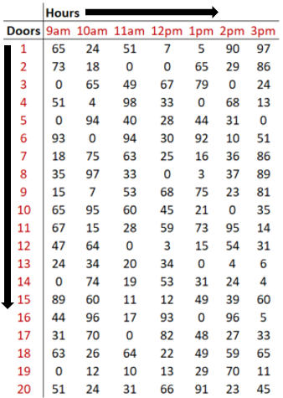
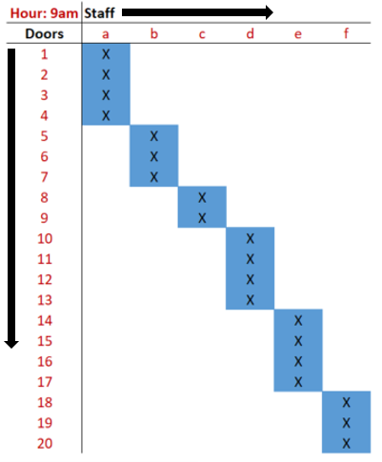



SDA is a tool that helps floor managers make optimal decisions when allocating staff, enabling productivity to be maximized throughout the day
Staff-to-Door Allocation Process with SDA
Data Input
Model Output
Allocation
Execution
Results
SDA receives data from facility’s automated sorting system, showing where cartons will be routed over course of the next hour.
SDA creates a report for the management team that contains optimal assignments of staff to sets of doors over the next hour.
Managers inform staff of their door assignments for the next hour.
Staff members work their assigned sets of doors until the next assignment.
Productivity increases, improving facility performance and minimizing labor cost.

Slide 6
A sample run of SDA against actual productivity metrics suggests that there is significant value in leveraging this data to make better decisions
SDA was run for a month, one hour at a time, using real volume data at a large distribution facility. Model results were compared to the actual hourly productivity results for those hours.
The recommended decisions by the model yielded productivity results as much as 18% higher than staff had been achieving with traditional techniques.
The model always found a way to assign sets of doors to associates to keep them at or above the target unless there simply was not enough work to do.
Productivity results were more stable and predictable over time, partially a result of smoothing out the volume

Slide 7
SDA can be customized to meet the needs of various allocation scenarios. If the Lake City FDC meets a few key criteria, we believe it could be a valuable tool
This tool is most valuable for facilities that meet the following criteria:
Staff productivity is suffering, stagnated or inconsistent
The management team needs to make complex resource allocation decisions very quickly with several, sometimes thousands, of available options. Factors that affect the complexity of the decision process include:
Size of the facility
Number of cartons routed through the facility in a typical day
Level of variation observed in carton flow throughout the facility over time
Number of staff, average number of doors per staff member, and average number of staff per manager
The number of cartons that will be routed to a door is known before staff allocation decisions need to be made, or can at least be modeled/predicted. If neither is possible, SDA can still be used as a benchmarking tool, comparing actuals to ideal state
Discussion Question
To what degree does the Lake City FDC fit these criteria?

Slide 8
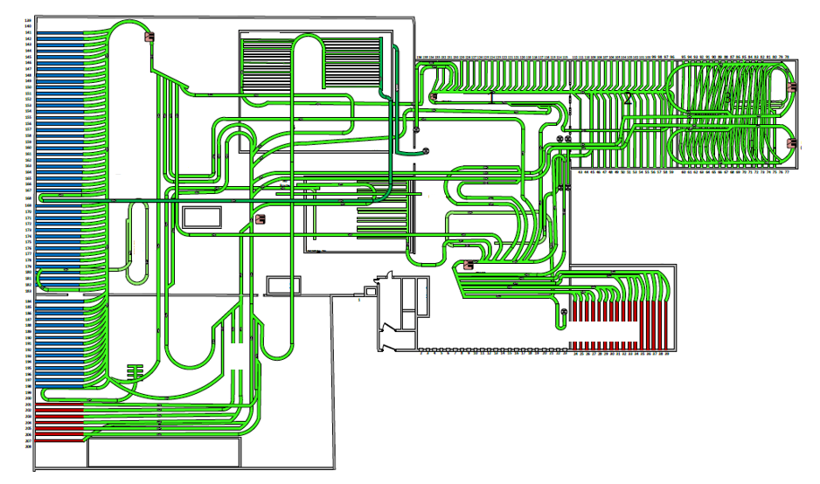
Appendix: Sample Cross-Dock DC

